Slide 1
LG Boosting

Slide 2
LG Boost
Leaf wise tree growth
Gradient boosting(combine weak models)
Copy data from Different sources
Supports binary, regression and multiclass

Slide 3

What is LG Boost

Slide 4
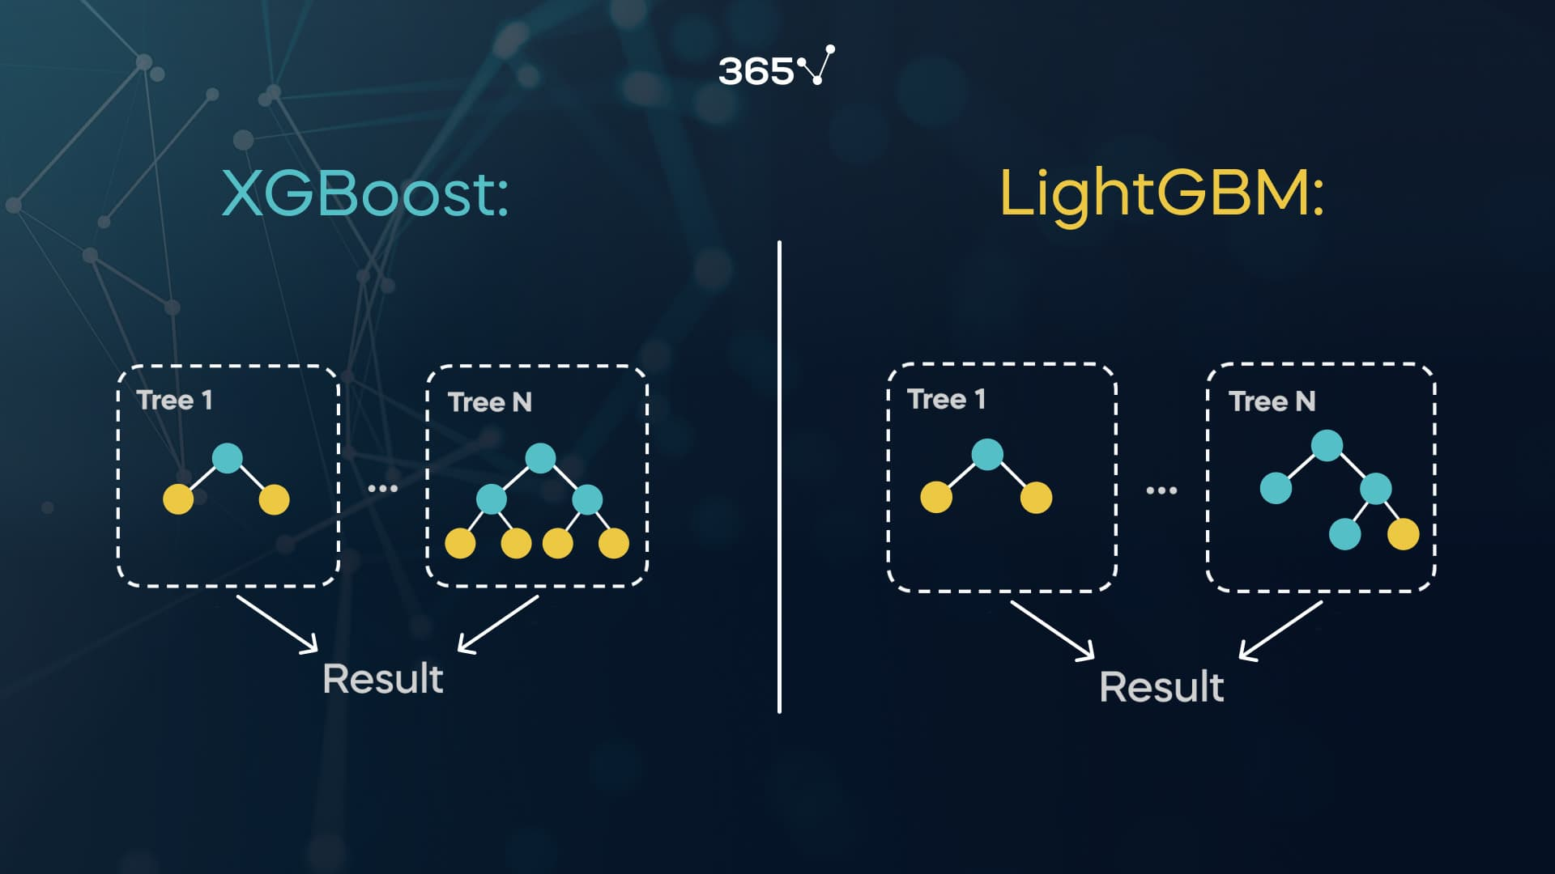
How it works

Slide 5
Advantages & Disadvantages
Advantages:
Handle millions of rows
Excellent speed but low memory consumption
Disadvantages
Not perform well on small datasets
High loss on one tree may result in less accuracy

